Slide 1



Machine Learning for Probability-Driven Match Outcome Prediction in IPL Cricket
A Data-Driven Approach to Predicting IPL Match Results
Pranit Gawade
26 AUG, 2024

Slide 2
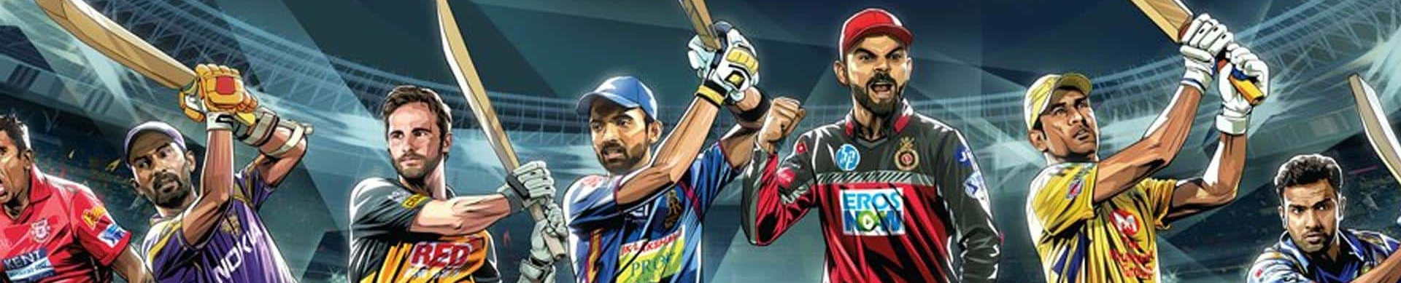
Introduction:
Context: The Indian Premier League (IPL) is a globally renowned cricket league with a massive fan base. Predicting match outcomes in such a high-stakes environment is valuable for various stakeholders.
Objective: Develop a machine learning model to predict match outcomes based on historical IPL data.

Slide 3

Background of the Study
Need for Predictive Models:
The rise of data analytics and machine learning offers a chance to apply these methods in sports. Predictive models can aid in team strategy, fan engagement, and betting insights.
Research Focus:
This study aims to develop a machine learning model using historical IPL data to predict match outcomes, offering a probabilistic understanding of game dynamics.

Slide 4

Problem Statement
This project aims to estimate the probability of winning and losing of batting team in second inning using machine learning models based on various features such as team, score progression, run rates, location, balls left and wickets left, the model estimates the probability of a team's victory during the match.

Slide 5
Importance of Prediction Models:
Stakeholders: Fans, analysts, and teams can benefit from accurate match outcome predictions.
Impact: Effective prediction models can influence decision-making, strategy formulation, and fan engagement.

Slide 6
Objective
Primary Goal:
Develop a machine learning model to predict IPL match outcomes based on historical match data.

Slide 7
Overview of Data Sources
Model is trained on past IPL Data from 2008 to 2024 .
Data Sources:
matches.csv: IPL match details dataset.
deliveries.csv: Ball-by-ball data for IPL matches.
Tools and Libraries:
Python, Pandas, Scikit-learn, Matplotlib

Slide 8
Workflow
Data Collection: Gather relevant and sufficient data for analysis.
Feature Engineering: Create and transform features to enhance model performance.
Feature Selection: Identify and retain the most impactful features for the model.
Model Training: Develop and fine-tune the predictive model using the prepared data.
Model Evaluation: Assess the model’s performance and generalization capabilities.

Slide 9

Data Collection
Datasets Used:
matches.csv: Contains details of IPL matches, such as teams, venue, toss winner, and match outcome.
deliveries.csv: Contains ball-by-ball data for each match, including batsmen, bowlers, runs scored, and dismissals.

Slide 10
Data cleaning
Data Cleaning Process:
Handling Missing Values: Imputed missing data where necessary.
Removing Duplicates: Ensured data integrity by removing any duplicate entries.

Slide 11
Data cleaning
Outlier percentage in numerical columns
Percentage of outlier in runs_left 0.08%
Percentage of outlier in wickets_left 0.96%
Percentage of outlier in total_runs_x 1.23%
Percentage of outlier in currunt_run_rate 4.85%
Percentage of outlier in required_run_rate 8.03%

Slide 12
Exploratory Data Analysis
EDA Overview:
Purpose: Identify patterns and trends in the data that could influence match outcomes.
Key Insights:
The impact of winning the toss on match outcomes.
The influence of venue on team performance.

Slide 13
Visualizing Key Features
Visualizing Key Features:
Example Visualizations:
Toss Decision: Bar chart showing the impact of batting or fielding first on match outcomes.
Venue Influence: Heatmap of win rates by venue.
Interpretation: How these features might impact the final prediction model.

Slide 14

Feature Engineering
Features Considered:
Batting team
City
Total runs x
Required run rate
Feature Transformation:
Encoded categorical variables using one hot encoding and created new features to capture the factors affecting match outcomes.
Bowling team
Wickets left
Currunt run rate
Result

Slide 15
Model Training
Training Process:
Data Split: Divided the data into training and testing sets.
Training Data - 70%
Testing Data - 30%

Slide 16
Model Training
Algorithms Used:
Logistic Regression ( Train Accuracy - 79.7%, Test Accuracy - 79.6% )
- A simple and efficient model for binary classification.
Random Forest ( Train Accuracy - 94.2%, Test Accuracy - 93.4% )
- An ensemble method that combines multiple decision trees for improved accuracy.
Support Vector Machine ( Train Accuracy - 76.9%, Test Accuracy - 77.4% )
- A powerful model that finds the optimal hyperplane to separate data points.
Votting Classifier ( Train Accuracy - 83.1%, Test Accuracy - 83.1% )
- Combines multiple models to leverage their strengths and improve prediction.

Slide 17
Model Evaluation
Performance Metrics:
Accuracy: How well the model predicted match outcomes.
Confusion Matrix: Provides a breakdown of true positives, false positives, true negatives, and false negatives.

Slide 18
Conclusion
Summary of Findings:
The machine learning model successfully predicted IPL match outcomes with a high degree of accuracy. Key factors influencing predictions included the runs left , wickets left , total runs x , currunt run rate, required run rate
Potential Applications:
The model could be useful for Analysts, Coaches, fan engagement and strategy development by teams.

Slide 19
Future Work
Model Improvement:
Incorporate more detailed player statistics and real-time data for better predictions.
Explore different machine learning techniques, such as ensemble learning or deep learning, to further improve accuracy.
Scalability:
Adapt the model to predict outcomes in other sports or leagues by incorporating sport-specific features and data.

Slide 20
Thank You
Dear Audience,
Thank you for your attention during my presentation !
If you have any questions, please feel free to ask.
Best regards,
Pranit Gawde

